Slide 1
Exploring Customer Behavior
BY-Satyapriya Mohanty

Slide 2
Table of Contents
Introduction
Overview of the Project
Objective of the Analysis
Data Information
Description of Datasets
Key Metrics and Data Points
Summary
Insights Gained from the Analysis
Key Findings and Trends
Problems & Analysis
Key Business Questions Addressed
SQL Queries and Their Results
Visual Representation of Findings
Conclusion
Key Takeaways
Business Recommendations
Future Scope and Next Steps

Slide 3
Overview of the Project - This project analyzes customer behavior on an online food ordering platform using SQL. The goal is to uncover insights into sales trends, customer preferences, and membership impact on revenue.
Objective of the Analysis- Identify high-performing products and customer spending patterns. Evaluate the impact of Gold membership on sales and retention. Provide data-driven recommendations for business growth.

Slide 4
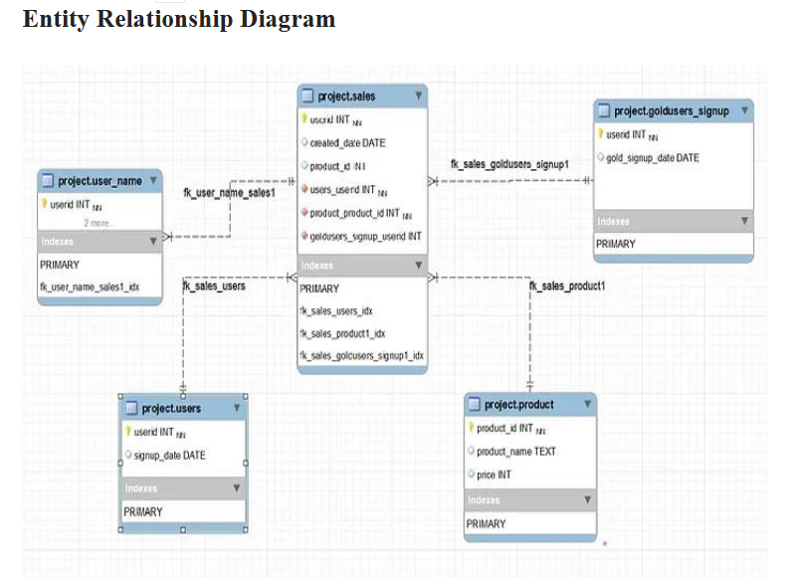

Slide 5
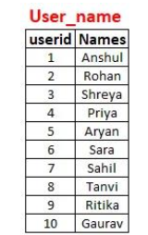
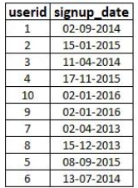
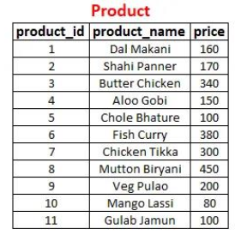
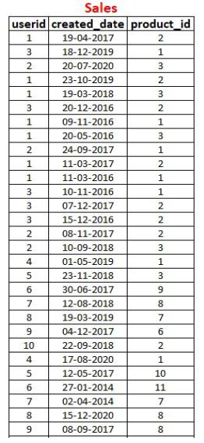
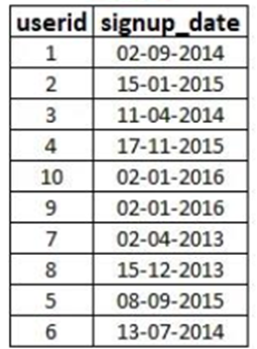
Users
Golduser_Signup

Slide 6
Insights Gained from the Analysis -The highest sales revenue was generated by three top-performing products. Gold members tend to spend more and have higher transaction frequency. Most users sign up for the platform but only a fraction convert to Gold members. Revenue from Gold users contributes significantly to total earnings. Customer purchase behavior changes after becoming a Gold member, with an increase in order frequency. Popular menu items are consistent among both regular and Gold users. Sales revenue has shown an increasing trend over the years. The first order made by users provides insights into product preferences upon sign-up.
Key Findings and Trends - The top three products contribute significantly to total revenue, indicating a need for promotions and inventory focus. Gold users have a higher lifetime value and engage more frequently than non-members . The majority of revenue is generated from a small percentage of highly engaged users . Customer retention is stronger among Gold members, justifying further investment in loyalty programs. Seasonal trends impact order frequency, suggesting potential for targeted marketing campaigns. First-time purchase patterns reveal key products that attract new users to the platform. Users tend to increase spending post-membership, highlighting the effectiveness of the loyalty program.

Slide 7
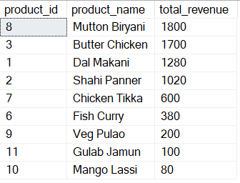

Problems & Analysis
1-The total sales revenue generated by each product
2-product has the highest sales revenue

Slide 8



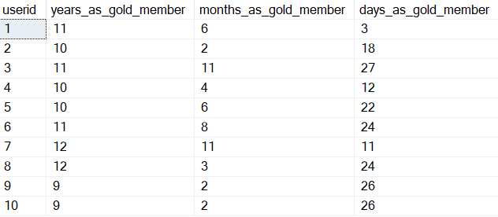
3-users have signed up for the service and has taken the gold membership
4-What is the revenue generated from gold users?
5-What is the total revenue generated from gold users?
6-Which users has been a gold user for the How much of time?

Slide 9

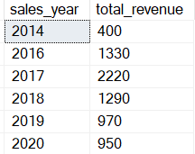
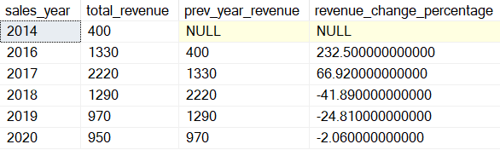
7-What is the most popular product among gold users?
8-What is the total sales revenue generated in each year?
9-How has the sales revenue changed over the years?

Slide 10

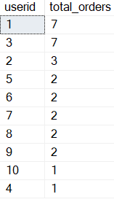

10-What is the average Gold-signup compare to just sign up for the users?
11-How many gold members users have order how many numbers of time ?
12-What is the most purchase item on the menu and how many times was it purchased by all customers?

Slide 11
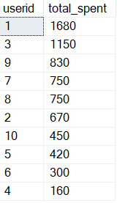
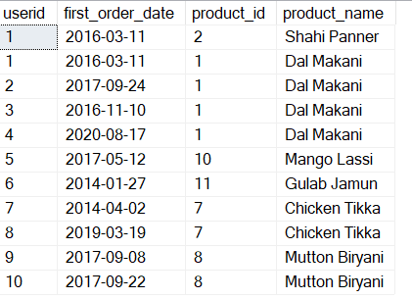
13-What is the total amount each customer spend on Online Food Delivery?
14-What was the first order purchase by each customer?

Slide 12
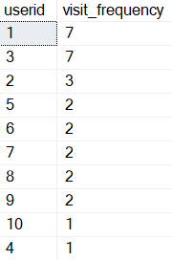
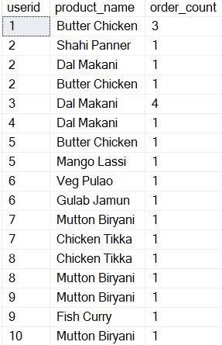
15- What is the frequency of customer visits to the online platform?
16-Which item was most popular for each customer ?

Slide 13
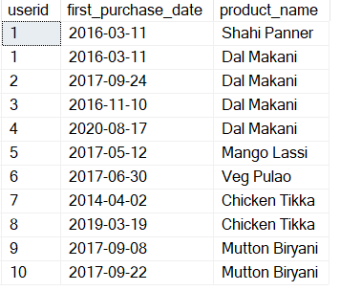

17-Which item was purchase first by the customer after they become a member ?
18-What is the total orders and amount spent for each member before they become a member?

Slide 14
Key Takeaways
Customer behavior analysis provides actionable insights for business strategy.
Gold membership programs positively influence revenue and user retention.
High-performing products should be prioritized in marketing and inventory.
Users increase spending and engagement after becoming Gold members.
Identifying purchase patterns can help tailor promotional campaigns.
Seasonal trends should be leveraged for marketing and sales strategies.
Providing non-SQL datasets to business teams can enhance decision-making.

Slide 15
Business Recommendations
Enhance Loyalty Programs: Since Gold users contribute significantly to revenue, consider offering additional incentives to encourage more users to upgrade.
Targeted Promotions for High-Performing Products: Invest in marketing campaigns and discounts for the top-selling items to maximize sales.
Optimize Pricing Strategies: Analyze pricing trends to adjust product prices for better customer engagement and profitability.
Improve Customer Retention Strategies: Introduce personalized offers and retention campaigns for non-Gold members to increase repeat purchases.
Leverage Seasonal Trends: Identify peak seasons and introduce time-limited deals to capitalize on high-traffic periods.
Analyze First-Purchase Behavior: Use insights from first-time purchases to optimize product placements and onboarding offers for new customers.
Provide SQL-Free Dashboards for Business Teams: To enhance accessibility, develop visual dashboards for non-technical stakeholders to analyze customer behavior trends.

Slide 16
Future Scope and Next Steps
Enhanced Customer Segmentation: Implement advanced data analytics and machine learning to segment users based on behavior, preferences, and spending habits for personalized marketing.
Real-Time Data Analysis: Introduce real-time tracking and dashboards to monitor customer transactions and engagement instantly.
Predictive Analytics: Utilize predictive modeling to forecast future sales trends, customer retention rates, and potential product demand.
Expansion of Loyalty Programs: Based on insights, introduce new tiers in the Gold membership program with additional benefits to attract more users.
A/B Testing for Marketing Campaigns: Test different promotional strategies to determine the most effective ways to increase conversions and customer retention.
Integration with External Market Data: Combine internal sales data with market trends to adjust pricing, promotions, and inventory strategies.
Automation of Reporting: Develop automated SQL queries and dashboards to generate periodic reports without manual intervention.
User Experience Improvements: Analyze user navigation patterns on the platform to improve the interface and checkout experience, reducing drop-off rates.

Slide 17
THANK YOU

